Slide 1
Unit 4 Applying Linear Equations
Algebra 1

Slide 2
Word Problem

Slide 3
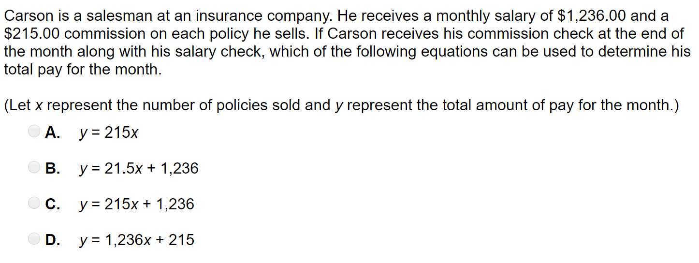
Word Problem

Slide 4
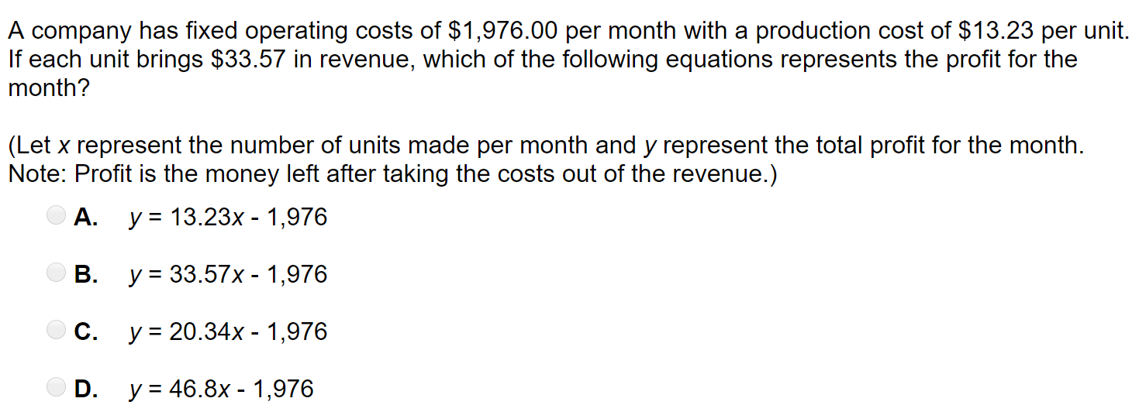
Word Problem

Slide 5
Word Problem

Slide 6
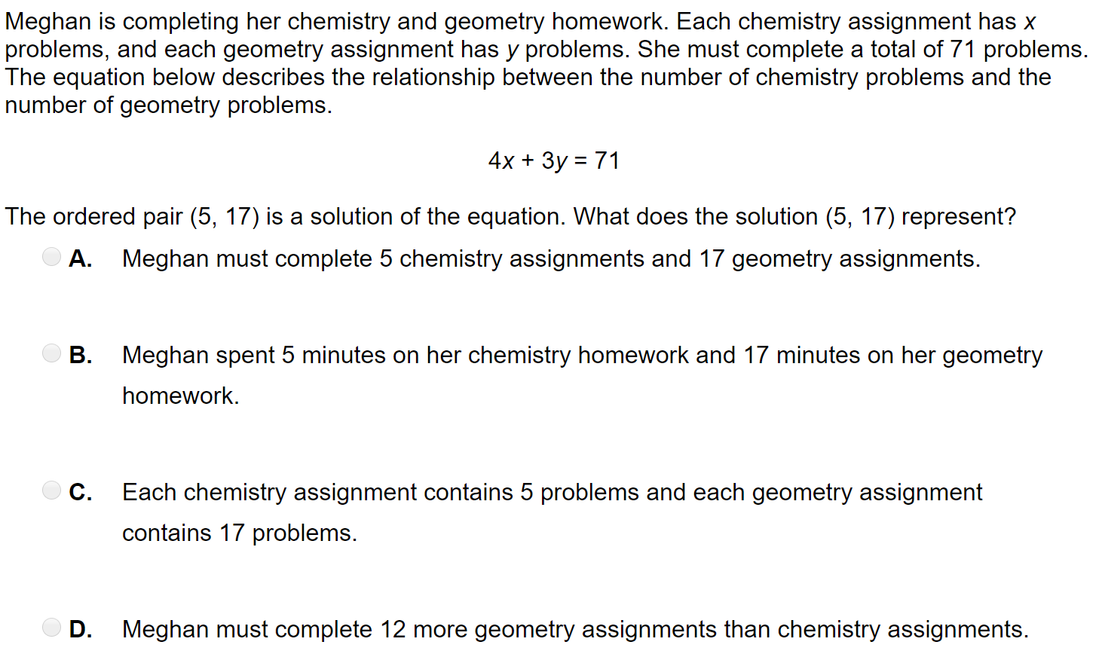
Word Problem

Slide 7
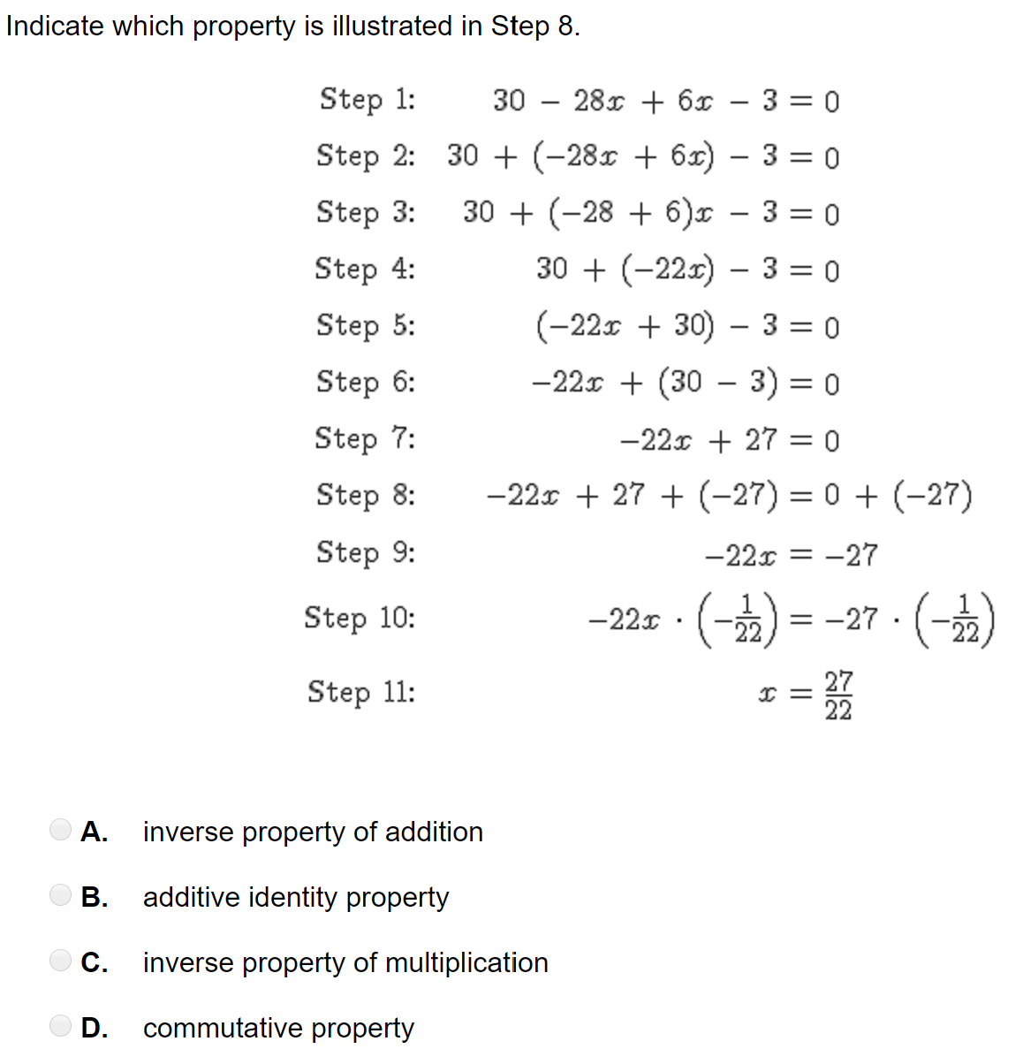
Word Problem

Slide 8
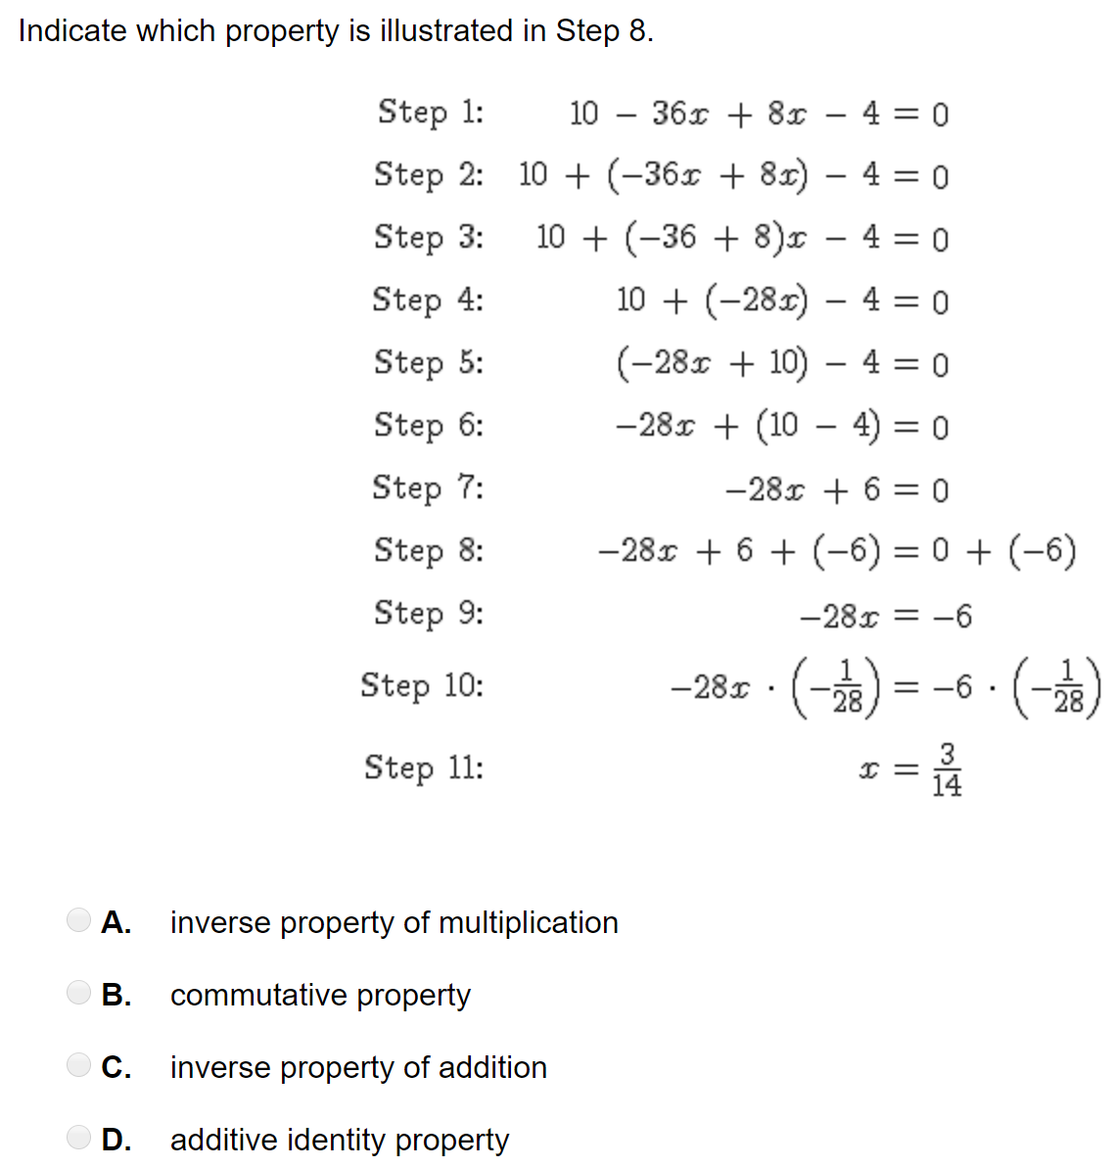
Word Problem

